Slide 1
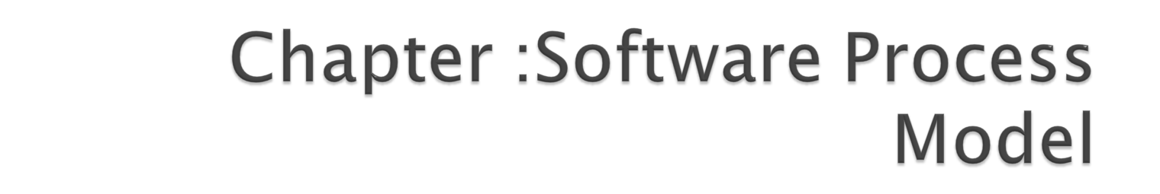

Slide 2

tools | It provide automated and semi automated support for the process and methods.
methods | It encompass a broad array of tasks that include communication, requirement analysis, design modelling, program construction, testing, and support software engineering.
process model | Process defines a framework for effective delivery of software engineering technology
a “quality” focus | Total quality management, six sigma, and similar philosophies foster a continuous process improvement culture.

Slide 3
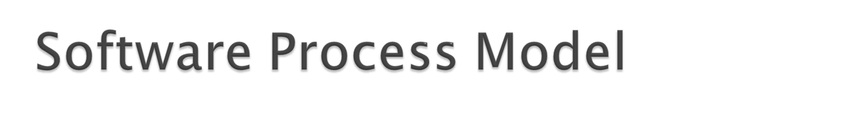
A Model has different Processes in it.
It is followed to produce high quality software.
It provides stability, control, and organization to a process.
They are adapted to meet the needs of software engineers and managers for a specific project.

Slide 4

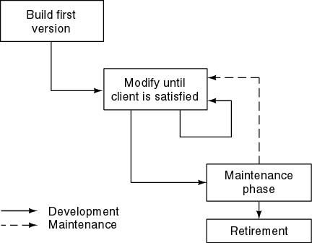
Product is constructed without specification or any attempt at design.
Developers simply build a product that is reworked as many times as necessary to satisfy the client.

Slide 5
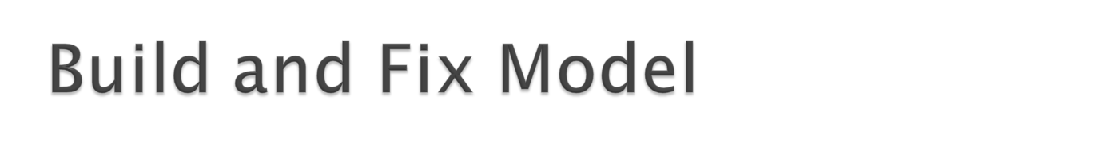
The earlier approach
Product is constructed without specification or any attempt at design.
developers simply build a product that is reworked as many times as necessary to satisfy the client.
model may work for small projects but is totally unsatisfactory for products of any reasonable size.
Maintenance is high.
Source of difficulties and deficiencies
  impossible to predict
  impossible to manage

Slide 6

Symptoms of inadequacy: the software crisis
  scheduled time and cost exceeded
  user expectations not met
  poor quality

Slide 7
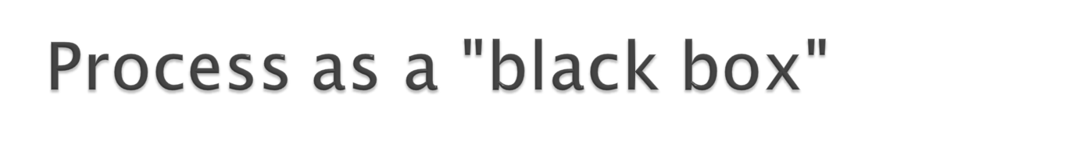
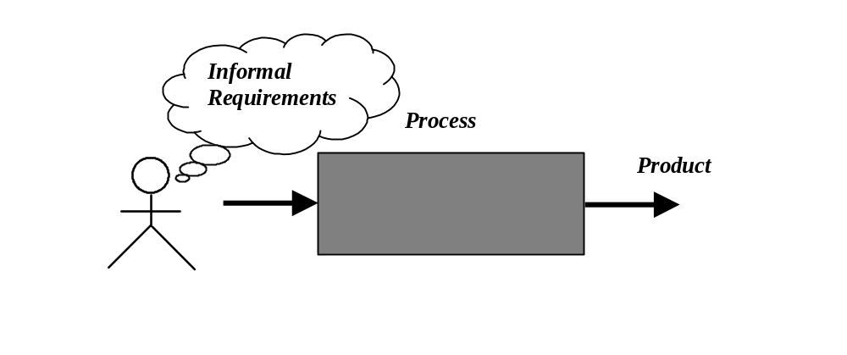
Quality?
Uncertain /
Incomplete requirement
In the beginning

Slide 8

The assumption is that requirements can be fully understood prior to development
Interaction with the customer occurs only at the beginning (requirements) and end (after delivery)

Slide 9

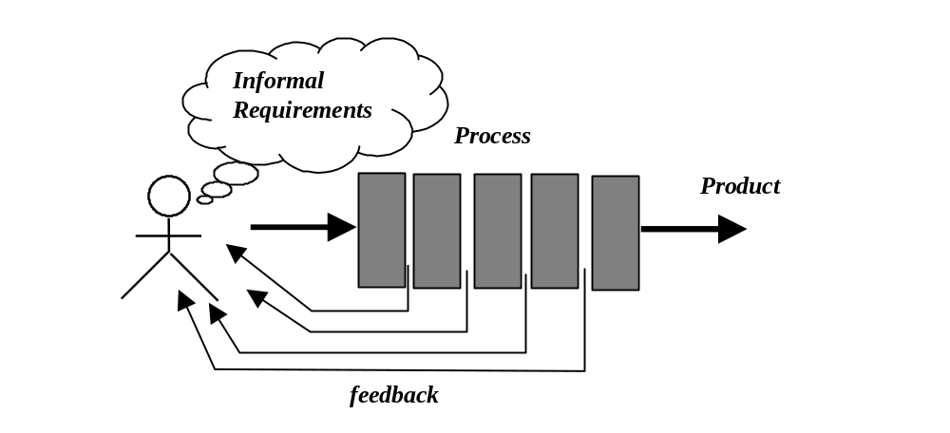

Slide 10

Reduce risks by improving visibility
Allow project changes as the project progresses
  based on feedback from the customer

Slide 11
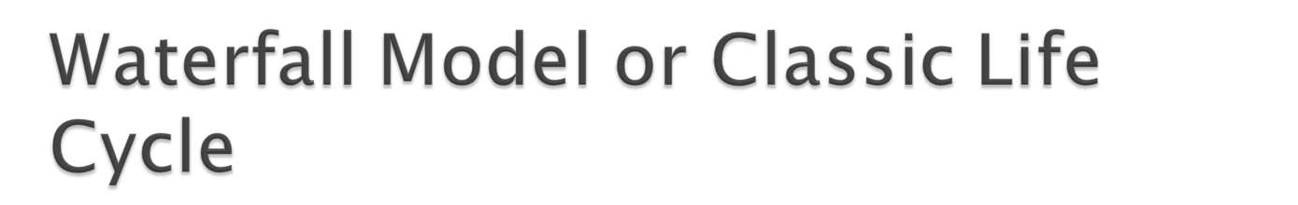
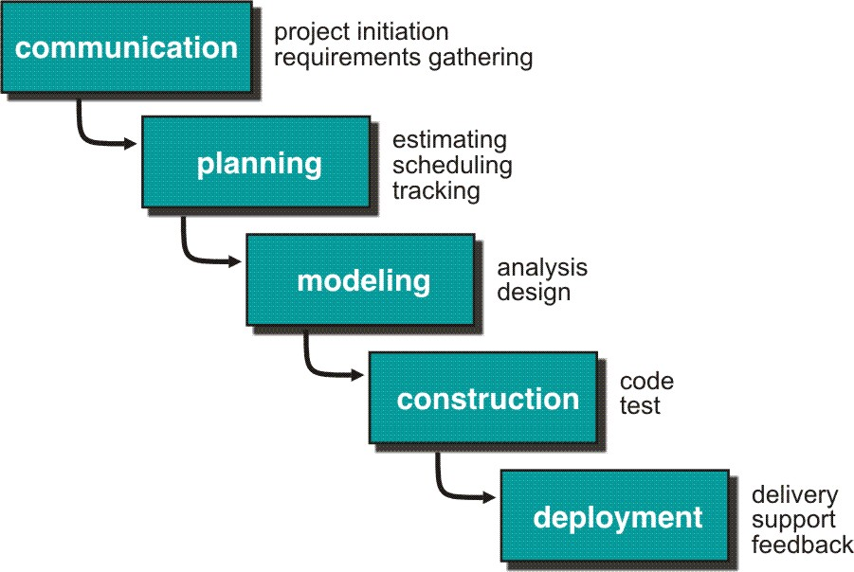

Slide 12

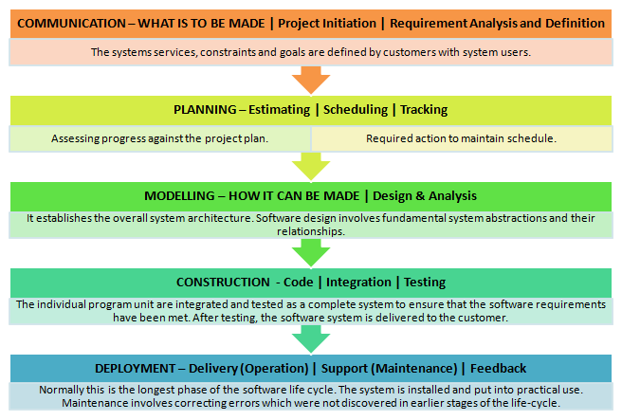

Slide 13

The nature of the requirements could not change during development.
The model implies that you should attempt to complete a given stage before moving on to the next stage
Does not account for the fact that requirements constantly change.
Customers can not view anything until the entire system is complete.
The model implies that once the product is finished, everything else is maintenance.
Surprises/changes at the end are very expensive.
Some teams sit ideal for other teams to finish
Therefore, this model is only appropriate when the requirements are well-understood and changes will be fairly limited during the design process.

Slide 14
Problems:
Real projects are rarely follow the sequential model.
Difficult for the customer to state all the requirement explicitly.
Assumes patience from customer - working version of program will not available until programs not getting change fully.

Slide 15

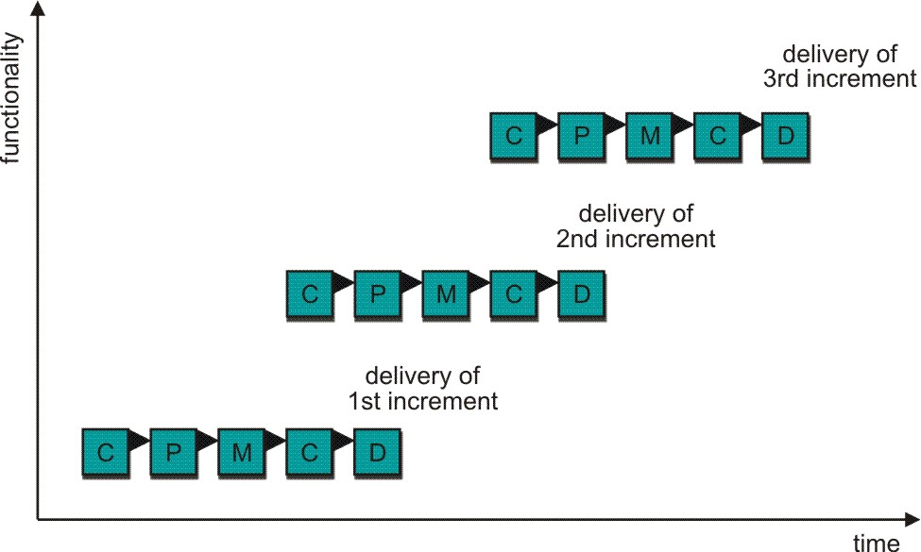
C- Communication
P - Planning
M – Modeling
C - Construction
D - Deployment
Need to provide a limited set of software functionality to users quickly and then refine and expand in later software releases.
Delivers software in small but usable pieces, each piece builds on pieces already delivered

Slide 16

The development and delivery is broken down into increments; with each increment delivering part of the required functionality.
First Increment is often core product
  Includes basic requirement
  Many supplementary features (known & unknown) remain undelivered
A plan of next increment is prepared
  Modifications of the first increment
  Additional features of the first increment
It is particularly useful when enough staffing is not available for the whole project
Increments can be planned to manage technical risks.
Incremental model focus more on delivery of operation product with each increment.

Slide 17

User requirements are prioritised and the highest priority requirements are included in early increments.
Once the development of an increment is started, the requirements are frozen though requirements for later increments can continue to evolve.
Early increments act as a prototype to help elicit (develop) requirements for later increments.
Lower risk of overall project failure.

Slide 18
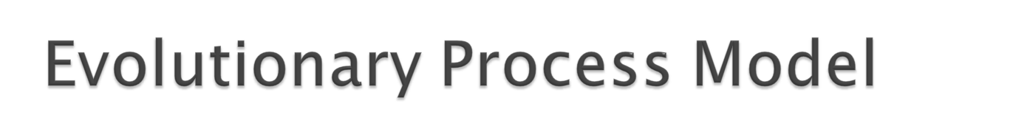
Produce an increasingly more complete version of the software with each iteration.
Evolutionary Models are iterative.
Evolutionary models are:
  Prototyping
  Spiral Model

Slide 19
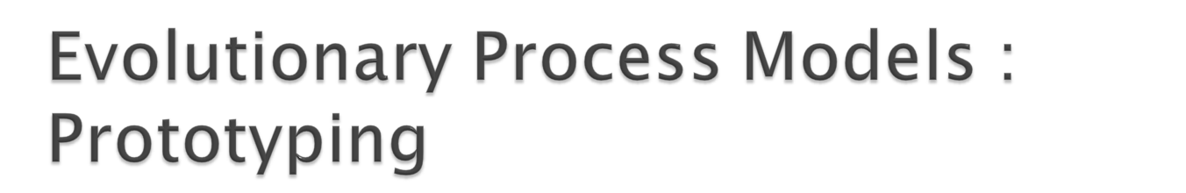
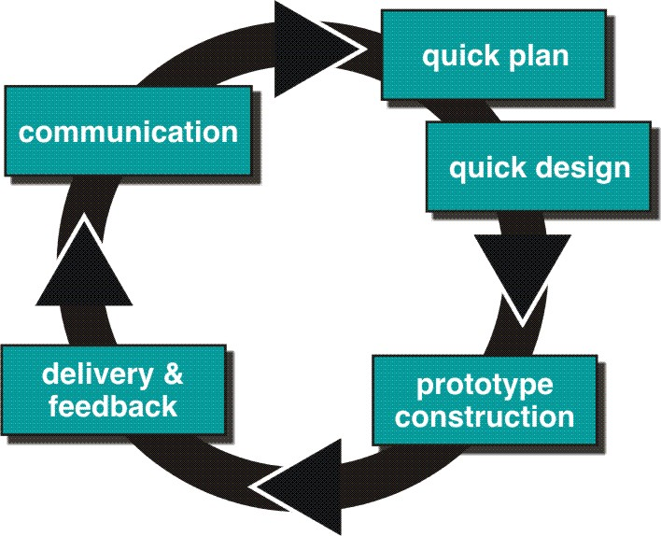

Slide 20
Best approach when:
  Objectives defines by customer are general but does not have details like input, processing, or output requirement.
  Developer may be unsure of the efficiency of an algorithm, O.S., or the form that human machine interaction should take.
It can be used as standalone process model.
Model assist software engineer and customer to better understand what is to be built when requirement are fuzzy.
Prototyping start with communication, between a customer and software engineer to define overall objective, identify requirements and make a boundary.
Going ahead, planned quickly and modeling (software layout visible to the customers/end-user) occurs.

Slide 21
Quick design leads to prototype construction.
Prototype is deployed and evaluated by the customer/user.
Feedback from customer/end user will refine requirement and that is how iteration occurs during prototype to satisfy the needs of the customer.
Prototype can be serve as “the first system”.
Both customers and developers like the prototyping paradigm.
  Customer/End user gets a feel for the actual system…very soon!
  Developer get to build something immediately.

Slide 22
Customer cries and demand that “a few fixes” be applied to make the prototype a working product, due to that software quality suffers as a result.
Developer often makes implementation in order to get a prototype working quickly without considering other factors in mind like OS, Programming language, etc.
Customer and developer both must be agree that the prototype is built to serve as a mechanism for defining requirement.

Slide 23
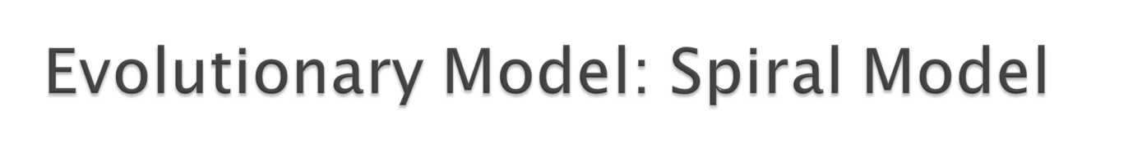
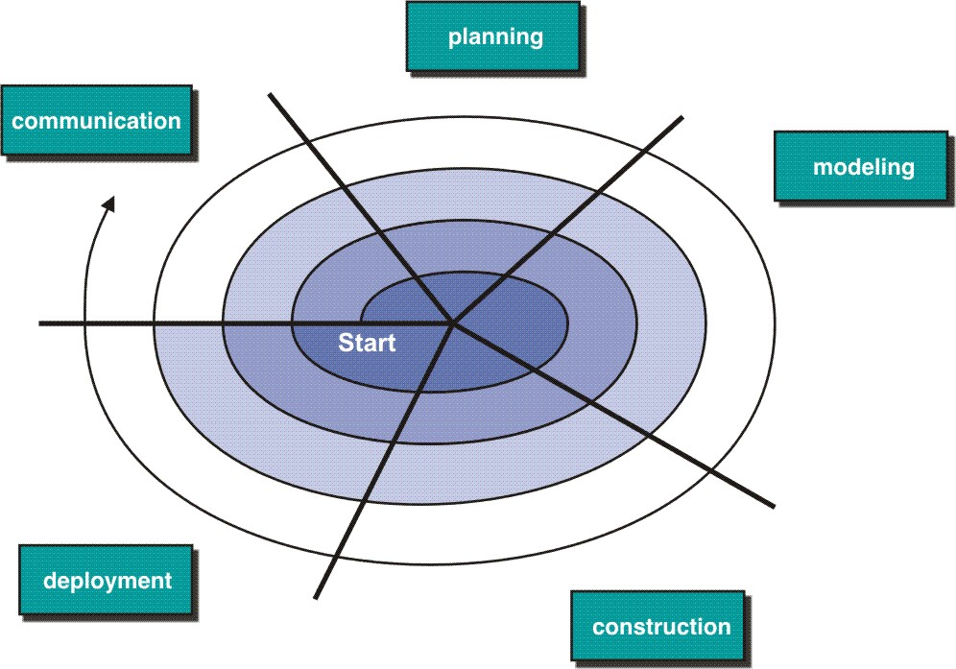

Slide 24
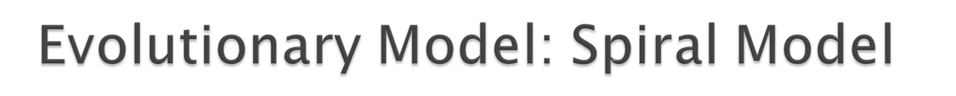
Iterative nature of prototyping + Waterfall = Spiral
Spiral model is a risk –driven process model generator.
Using spiral, software developed in as series of evolutionary release.
  Early iteration, release might be on paper or prototype.
  Later iteration, more complete version of software.
Divided into framework activities (C,P,R,M,C,D). Each activity represent one segment.
Evolutionary process begins in a clockwise direction, beginning at the center risk.
First circuit around the spiral might result in development of a product specification. Subsequently, develop a prototype and then progressively more sophisticated version of software.

Slide 25
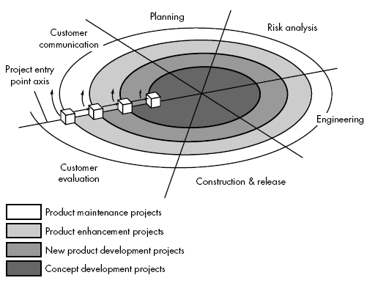

Slide 26
Concept Development Project:
Start at the core and continues for multiple iterations until it is complete.
If concept is developed into an actual product, the process proceeds outward on the spiral.
New Product Development Project:
New product will evolve through a number of iterations around the spiral.
Later, a circuit around spiral might be used to represent a “Product Enhancement Project”
Product Enhancement Project:
There are times when process is dormant or software team not developing new things but change is initiated, process start at appropriate entry point.

Slide 27
Problem Area:
It may be difficult to convince customers (particularly in contract situations) that the evolutionary approach is controllable.
If a major risk is not uncovered and managed, problems will undoubtedly occur.

Slide 28
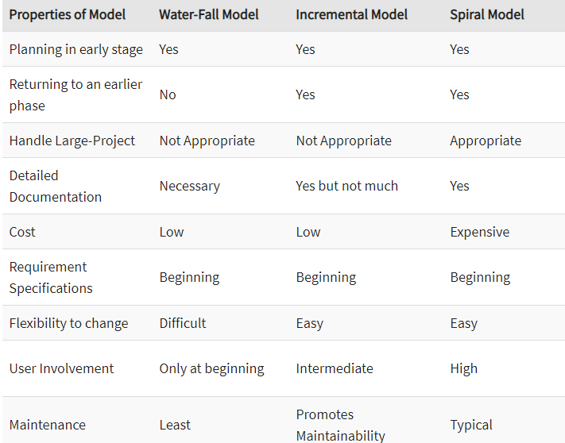

Slide 29
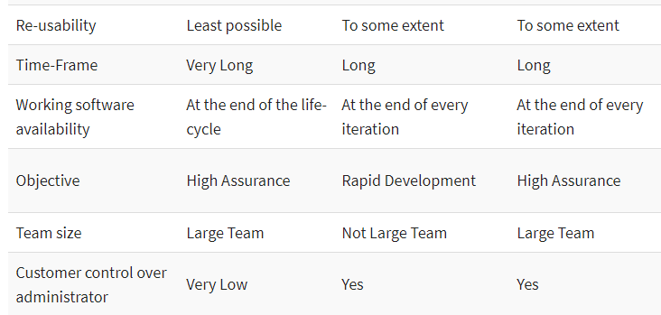

Slide 30
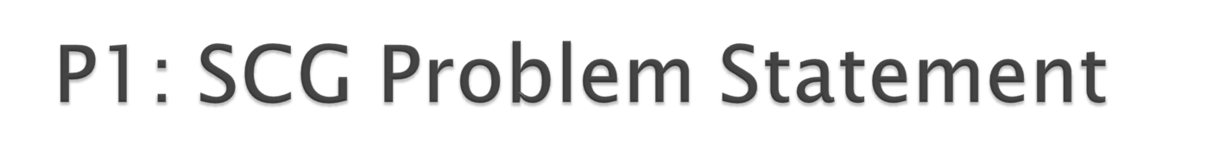
SCG/Avatar supports a game-based software development process for computational problems CP defined by an input/output mapping. At least two competing and collaborating teams develop an avatar containing software for CP. The goal of the game is to have a focused, productive discourse about CP between the avatars, and indirectly, between the software teams, to find good software/algorithms for CP and to fairly evaluate all proposed solutions. The CP software is embedded in an avatar that proposes and opposes claims about how well CP can be solved.
There are many computational problems for which we want to develop high-quality software through SCG. Therefore we want to develop community support for running all those games for all those computational problems. Each computational problem uses different concepts and notations. It is a big advantage for the software developer when there is a consistent interface for all problems.
We want to use the SCG/Avatar game to (1) develop reliable software for computational problems, (2) evaluate potential employees, (3) develop new knowledge in the given domain, (4) evaluate algorithmic innovations fairly

Slide 31
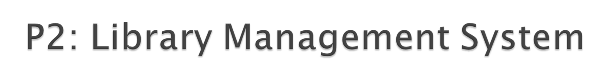
Library management software for the purpose of monitoring and controlling the transactions in a library. This case study on the library
management system gives us the complete information about the library and the daily transactions done in a Library. We need to maintain the record of new s and retrieve the details of books available in the library which mainly focuses on basic operations in a library like adding new member, new books, and up new information, searching books and members and facility to borrow and return books. It features a familiar and well thought-out, an attractive user interface, combined with strong searching, insertion and reporting capabilities. The report generation facility of library system helps to get a good idea of which are ths borrowed by the members, makes users possible to generate hard copy. The following are the brief description on the functions achieved through this case study: End-Users:•Librarian: To maintain and update the records and also to cater the needs of the users.•Reader: Need books to read and also places various requests to the librarian.•Vendor: To provide and meet the requirement of the prescribed books.

